Slide 1
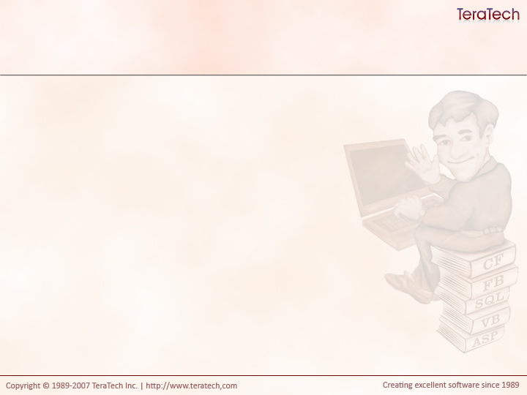
Getting Started With
Model-Glue:Unity
Introductions

Slide 2
Your Instructor: Doug Hughes
Working with Model-Glue since the very beginning
  Roughly, March 2005
First person (other than Joe) to use Model-Glue
  Version 0.4, I think
Contributed in many ways to the framework
Came to Model-Glue from Mach-II

Slide 3
You will learn… (Day 1)
How to write and use CFCs
Why you want to use a framework like Model-Glue
About design patterns
How to get started with Model-Glue
How to do something useful with Model-Glue

Slide 4
You will learn… (Day 2)
In depth Model-Glue
How to getting started with Unit Tests
Data Access design patterns
How to wiring it all together with ColdSpring

Slide 5
You will learn… (Day 3)
How to pull everything together and write something useful.
We will start porting a few sections of the PITS application using the techniques we learned.

Slide 6
Who are you?
What’s your name?
What do you do at Carfax?
What’s your experience?
Ever used a framework?
What’s you favorite type of work?
  Database?
  Logic?
  Debugging?
  Something else?

Slide 7
Let’s talk Carfax Development
How successful are your products?
How do you write code?
What are your standard practices?
Do you use source code control?
How do you test code?
Do you have a bug database?
What are the most frequent types of problems you experience?

Slide 8
Let’s talk Object Oriented Experience
Do you use CFCs?
Have you used any frameworks?
Why do you want to learn Model-Glue (and therefore OO)?

Slide 9
Exercise One: Code Procedurally
You have 20 minutes
Using the Fortune database…
Write a simple form with a drop down of categories (see the Category table) that submits to…
Another page which will display a random fortune from the selected category.
    SELECT TOP 1 fortuneId, categoryId, fortune
    FROM Fortune
    WHERE categoryId = #categoryId#
    ORDER BY newId()
Use only CFM files.
Write the best code you can.
Let me know when you’re done.
Notes:
When everyone’s done ask them to apply a common template just to illustrate changes.
Ask them to show the number of fortunes next to each category in the list.
Ask them to show the name of the category on the fortune page.
Ask them to change the name of the datasource they’re using.

Slide 10
Requirements Change!
Apply a common header and footer to your application.
Show the number of fortunes in each category in the drop down.
Show the name of the category on the fortune page.

Slide 11
Let’s Discuss
What were some of the techniques applied?
  Why?
If you had more time what would you have done differently?
If you could have used components what would you have done?
How did the requirements changes impact your code?
What were some of the challenges?
What work was involved in making the changes?
What if, rather than using the database, we changed to use a web service?

